Slide 1
Component Testing
Submitted by : Submitted to: Prof. Mike Aleshams
Gurvinder Singh
Ankit Patel
Krutika

Slide 2
Contents
HX711 and 50kg Load Cell Weight Sensor
LTE Module
MQ-2 Gas Sensor
LPC1769
References

Slide 3
HX711 and 50kg Load Cell
Steps:
Need to connect load cell and HX711 with Arduino board.
Arduino IDE to run the code.
Add HX711 libraries to Arduino IDE.
Put Code in Arduino IDE along with HX711 libraries.
Upload the code to Arduino Board.
Serial Monitoring(Serial connection with PC).
Note the readings.

Slide 4
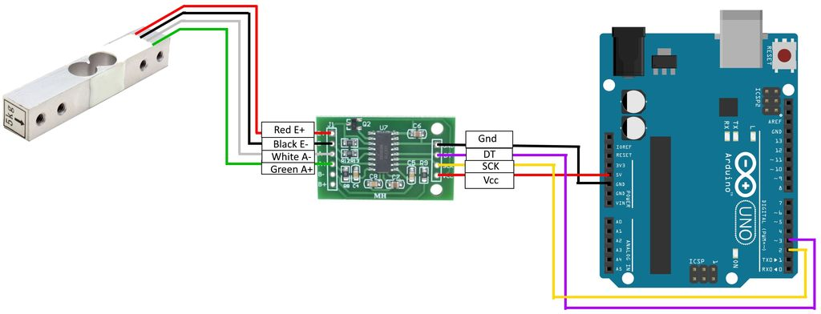
HX711 and 50kg Load Cell Connection

Slide 5
HX711 and 50kg Load Cell (Youtube Video Link)
https://www.youtube.com/watch?v=OM_b41aRwhc

Slide 6
LTE Module
Steps:
Need SSCOM software.
LTE module.
Sim card.
Connect Antenna to main slot.
Use AT commands for testing.
Have on-board USB-UART Interface.
Easy to make direct connection between MCU USB port and Modem
Port COM4 should be selected for the required operation.
Baud rate = 115200

Slide 7
AT Commands
AT+CPIN = to check the sim card status.
AT+COPS = to check the network provider.
AT+CNUM = to check the mobile number.
AT+CSQ = to check the signal quality.

Slide 8
LTE Module Youtube video link
https://www.youtube.com/watch?v=Ti1C99tlBOQ

Slide 9
MQ-2 Gas Sensor
Requirements:
Arduino.
Arduino IDE.
Breadboard.
Jumper wires.

Slide 10
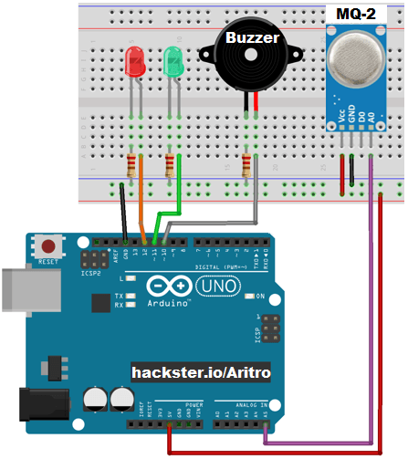
MQ-2 Gas Sensor Connections

Slide 11
MQ-2 Gas Sensor Youtube video link
https://www.youtube.com/watch?v=VcdJ5sYGPYU

Slide 12
LPC1769
LPC 1769
MCUXpresso IDE
Code to blink three leds(red, blue, green)

Slide 13
LPC1769 Youtube video link
https://www.youtube.com/watch?v=jtN9a_4AUYc

Slide 14
Reference
Arduino Scale With 5kg Load Cell and HX711 Amplifier, DegrawSt , November 2014
https://www.instructables.com/id/Arduino-Scale-With-5kg-Load-Cell-and-HX711-Amplifi/
SIM7600CE-T/E-H/A-H/G-H 4G Modules, Modified on May 26, 2020
https://www.waveshare.com/wiki/SIM7600A-H_4G_HAT
Smoke Detection using MQ-2 Gas Sensor, Published on May 6, 2016
https://create.arduino.cc/projecthub/Aritro/smoke-detection-using-mq-2-gas-sensor-79c54a

